Slide 1
Lecture 10 Incentive Design: Badges and Attention
Instructor: Chien-Ju (CJ) Ho

Slide 2
Logistics: Deadlines
Assignment 2: Due this Friday
Assignment 3: Due Oct 13 (Wed)
Project milestone 1: Due Oct 15 (Fri)
Initial literature survey (know what other works are out there)
A plan on what you want to do for the remaining of the semester
Formalize your research question and approaches, e.g.,
Theory/simulation project: formalize your models
Data-analysis project: figure out where and how to get data and what you plan to do with it
Experiment/application project: have a prototype design and an evaluation plan
Include a timeline (weekly or biweekly) on what you plan to do
Nov 2: Midterm Project Pitch
Nov 5: Milestone 2

Slide 3
Logistics: Review Submission
For book-keeping purposes, if you are the presenters of the lecture, please answer a single question for the review of your lecture.

Slide 4
Recap on Game Theory Basics

Slide 5
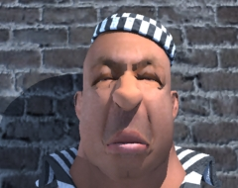
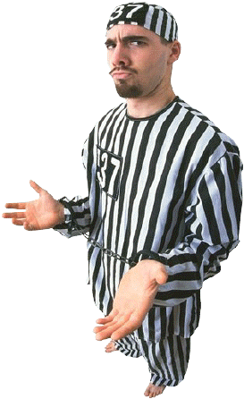
Game Theory Basics
Key elements of game theoretical models
Players, strategies, payoffs
Normal-form game
B
 | Stay Silent | Confess
Stay Silent | A: 6 months B: 6 months | A: 10 years B: free
Confess | A: free B: 10 years | A: 5 years B: 5 years
A

Slide 6
Game Theory Basics
Key elements of game theoretical models
Players, strategies, payoffs
Extensive-form game
Teacher
Don’t give a test
Give a test
Student
Student
Study
Relax
Prepare
Cheat
(3,1)
(1,3)
(2,1)
(0,0)

Slide 7
Solutions Concepts
Informally, predictions of what rational agents will do given the game
Nash equilibrium
If everyone else follows Nash equilibrium, it’s your best interest to follow
B
 | Movie | Bar
Movie | (2, 1) | (0, 0)
Bar | (0, 0) | (1, 2)
A
(Movie, Movie) and (Bar, Bar) are pure strategy Nash equilibria
Generally speaking, finding a Nash is hard, but verifying whether it’s a Nash is easy

Slide 8
Solutions Concepts
Informally, predictions of what rational agents will do given the game
Subgame perfect equilibrium
Play in each ”subgame” is a Nash equilibrium
Teacher
Don’t give a test
Give a test
Subgame perfect equilibrium
Teacher chooses “Give a test”
Student chooses (“Relax”, “Prepare”)
Student
Student
Study
Relax
Prepare
Cheat
(3,1)
(1,3)
(2,1)
(0,0)

Slide 9
Mechanism Design
Game theoretical analysis
Given the game, analyze what rational agents will do
Mechanism design (reverse game theory)
Give a goal of what you want rational agents do, design the game rules (e.g., what payoffs agents can receive) such that agents choose the actions you want them to choose.

Slide 10
Badge as Incentives
Steering User Behavior with Badges. Anderson et al. WWW 2013.

Slide 11
Warm-up Discussion
Have you ever been incentivized by badges? Share your experience with other students.
Discuss on whether those badges can be designed better? Try to more formally describe the aspects of design and define what you mean by better.
Think of this as a practice to ”model” the world that you care about.

Slide 12
Modeling Badges
Focus on threshold badges
Representation of threshold badges:
Earn a badge for “taking an action K times”

Slide 13
Modeling Badges as Incentives
Key elements in modeling incentives
Players, Action space, Payoff
One naïve model for threshold badges
Players: Only single user since there is no user interaction in threshold badges
Action space: # actions the user decides to take
Payoff: Utility( HasBadge(# actions) ) - Cost(# actions)
Model prediction: Users take actions that maximizes payoff
This model helps answer some questions but not others
What can this model tell us?

Slide 15
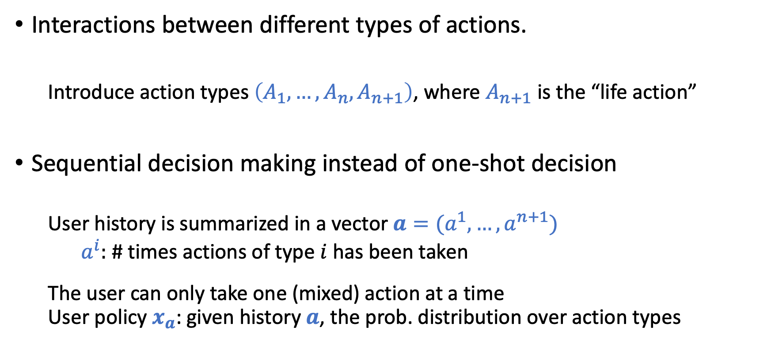
Modeling Badges (Action)
Interactions between different types of actions.
Introduce action types $\left(A_{1}, …, A_{n}, A_{n+1}\right)$, where $A_{n+1}$ is the “life action”
Sequential decision making instead of one-shot decision
User history is summarized in a vector $a=(a^{1},…,a^{n+1})$
$a^{i}:$ # times actions of type $i$ has been taken
The user can only take one (mixed) action at a time User policy $x_{a}$: given history $a$, the prob. distribution over action types

Slide 16
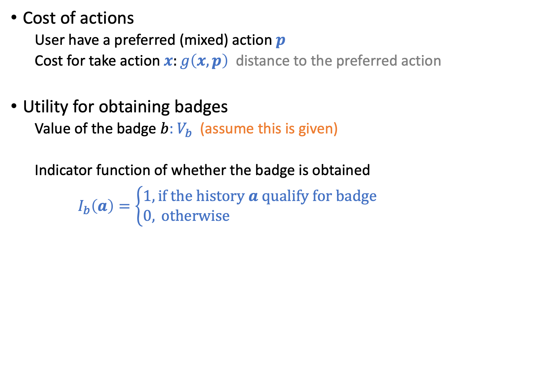
Modeling Badges (Payoff)
Cost of actions
User have a preferred (mixed) action $p$
Cost for take action $x:g\left(x,p\right)$ distance to the preferred action
Utility for obtaining badges
Value of the badge $b$: $V_{b}$ (assume this is given)
Indicator function of whether the badge is obtained
$I_{b}\left(a\right)=\left\{\begin{aligned}1, \text{if} \text{the} \text{history} a \text{qualify} \text{for} \text{badge} \\ 0, \text{otherwise} \end{aligned}\right.$

Slide 17
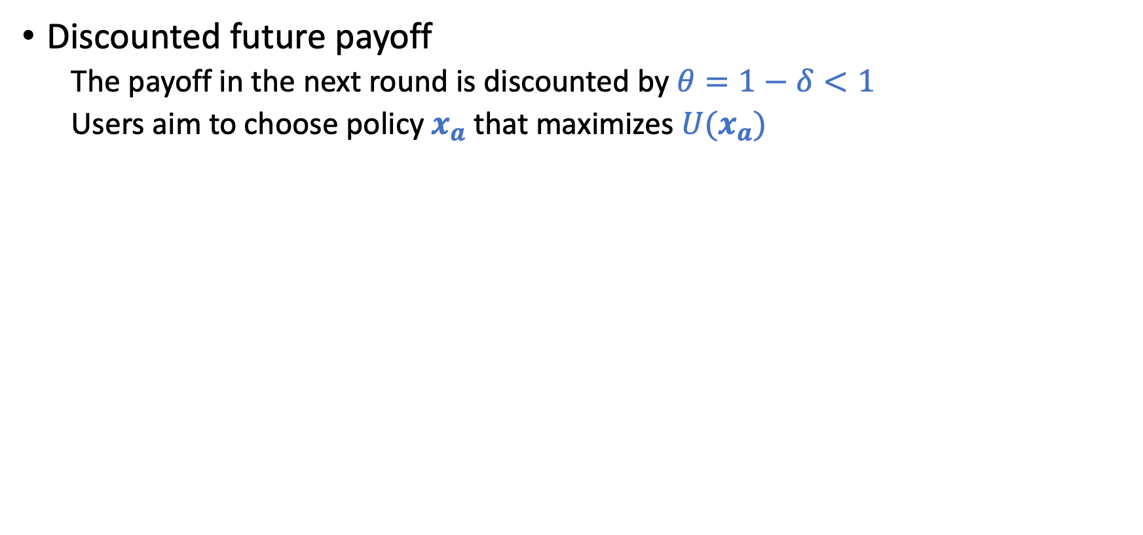
Modeling Badges (Payoff)
Discounted future payoff
The payoff in the next round is discounted by $θ=1−δ<1$
Users aim to choose policy $x_{a}$ that maximizes $U(x_{a})$
Payoff from current badges
Cost of action
Payoff from “future” badges from actions
Think about what actions users will take if we believe this model is correct?

Slide 18
Model Predictions
More sensitive to badges when closer to obtaining it.
Increase the action of one type decrease the others.
The incentive of a badge disappears after obtaining it.

Slide 19
Model Predictions

Slide 20
Empirical Evidence from Stack Overflow

Slide 21
Badge Design
How to optimally design the badges?
Single threshold badge: what is the optimal threshold
The paper discusses more design questions, but be careful on what the model/evidence really captures.

Slide 22
Other Badges
Requires a “sustained” performance
Associates with quality
And more …(e.g., requires competition)

Slide 23
Final Notes
Connections to gamification, social status, and reputation systems.
For all these modeling work, try to always remind yourself what the settings/assumptions are, and consider when/whether they might be useful.

Slide 24
Discussion
Have you ever been incentivized by badges? Share your experience with other students.
Discuss on whether those badges can be designed better? Try to more formally describe the aspects of design and define what you mean by better.
Think of this as a practice to ”model” the world that you care about.
What additional features/perspectives do you think are the most interesting/important next questions to ask for badge design?

Slide 25
Attention as Incentives
Incentivizing High-Quality User-Generated Content. Ghosh and McAfee. WWW 2011.

Slide 26



User-Generated Content Platforms
Content is generated by users instead of the platform
Why do people post content on YouTube, Instagram, Quora?

Slide 27
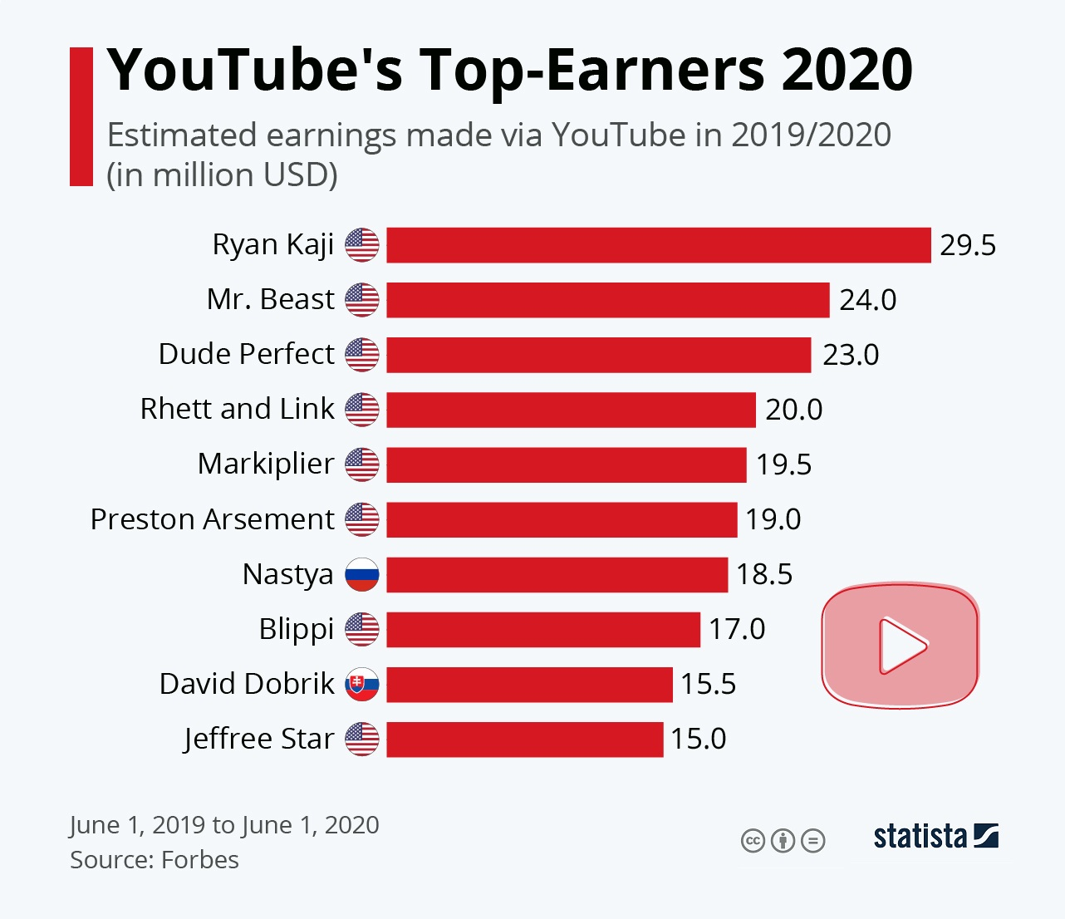
Attention is One of the Major Incentives
Psychological motivation
Probably more importantly, Attention => Money (e.g., through advertisements)
Platforms have huge power on influencing which content will receive more attention

Slide 28
Assuming attention is the main motivation for contributors, how should the platform design their content displaying algorithm?

Slide 29
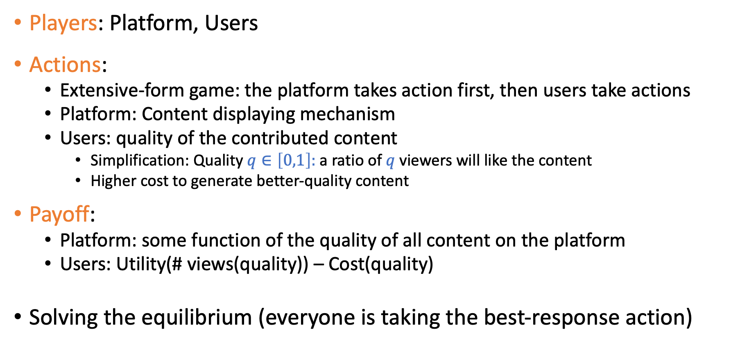
Modeling Attention as Incentive
Players: Platform, Users
Actions:
Extensive-form game: the platform takes action first, then users take actions
Platform: Content displaying mechanism
Users: quality of the contributed content
Simplification: Quality $q∈\left[0,1\right]:$a ratio of $q$ viewers will like the content
Higher cost to generate better-quality content
Payoff:
Platform: some function of the quality of all content on the platform
Users: Utility(# views(quality)) – Cost(quality)
Solving the equilibrium (everyone is taking the best-response action)
Common assumptions:
Utility is concave/submodular
Cost is convex/supermodular

Slide 30
More Settings/Assumptions
The platform aims to allocate M views to K contributors (assuming viewers just read/watch whatever the platform recommends)
Extensive-form game
1. The platform announces her allocation mechanism
2. K contributors simultaneously decide on the quality of their contributions
Each contributor aims at maximizing Utility(# views(quality)) – Cost(quality)

Slide 31
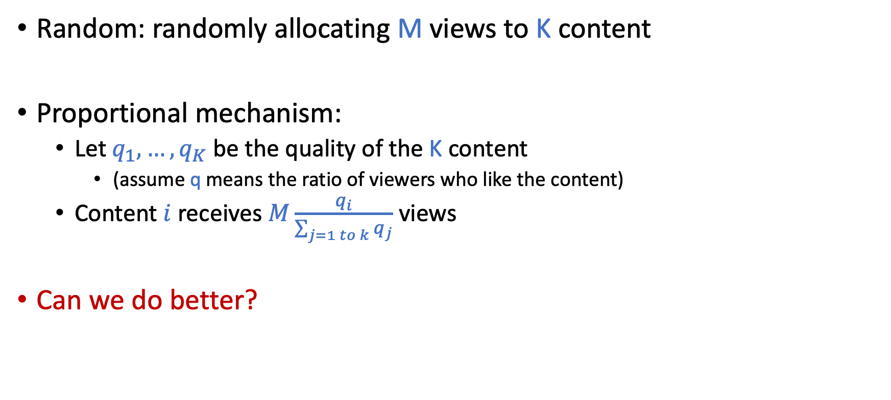
Mechanisms
What are the outcomes of the mechanism? Assumption: Each contributor aims at maximizing Utility(# views(quality)) – Cost(quality)
Random: randomly allocating M views to K content
Proportional mechanism:
Let $q_{1},…,q_{K}$ be the quality of the K content
(assume q means the ratio of viewers who like the content)
Content $i$receives $M\frac{q_{i}}{\sum_{j=1 to k}{q_{j}}}$ views
Can we do better?
Flood of bad content
Requires good estimate of q
Quality converge to a suboptimal value

Slide 32
Mechanisms
What are the outcomes of the mechanism? Assumption: Each contributor aims at maximizing Utility(# views(quality)) – Cost(quality)
Elimination mechanism:
Each content is evaluated by a random select of A viewers
Only when all A viewers like the content, it goes to the 2nd stage
All content in 2nd stage equally shares the remaining views
By tuning A, content quality might achieve optimal
Simultaneously estimate content quality.

Slide 33
Additional follow-up work
Mixture of learning and incentives: [Ghosh and Hummel. ITCS 2013]
Showing a content to viewers:
Create incentives for contributors
Platform can learn content quality from viewer feedback
How to simultaneously address joint issues of learning and incentives
Incorporating human biases in learning [Tang and Ho. AAMAS 2019]
Herding Effect

Slide 34
Discussion
We have discussed the incentive design problem for financial incentives and non-financial incentives such as badges and attention.
What are the other types of incentives you think we can utilize to promote human-in-the-loop computation?
Reputation, access to information, recommendation accuracy, etc
How do you model and analyze the incentives?
Players, actions, payoff? What’s the equilibrium? How to perform the design?

Slide 35
Proper Scoring Rules

Slide 36
Incentivizing Truthful Reports About Probabilities
Example scenarios:
Ask a weather forecaster: will it rain tomorrow?
Ask a political researcher: will Trump win 2020 election?
Ask a Microsoft employer: will the new version of Office be shipped on time?
Want to obtain forecasts about future events
How do we make sure we obtain truthful reports?

Slide 37
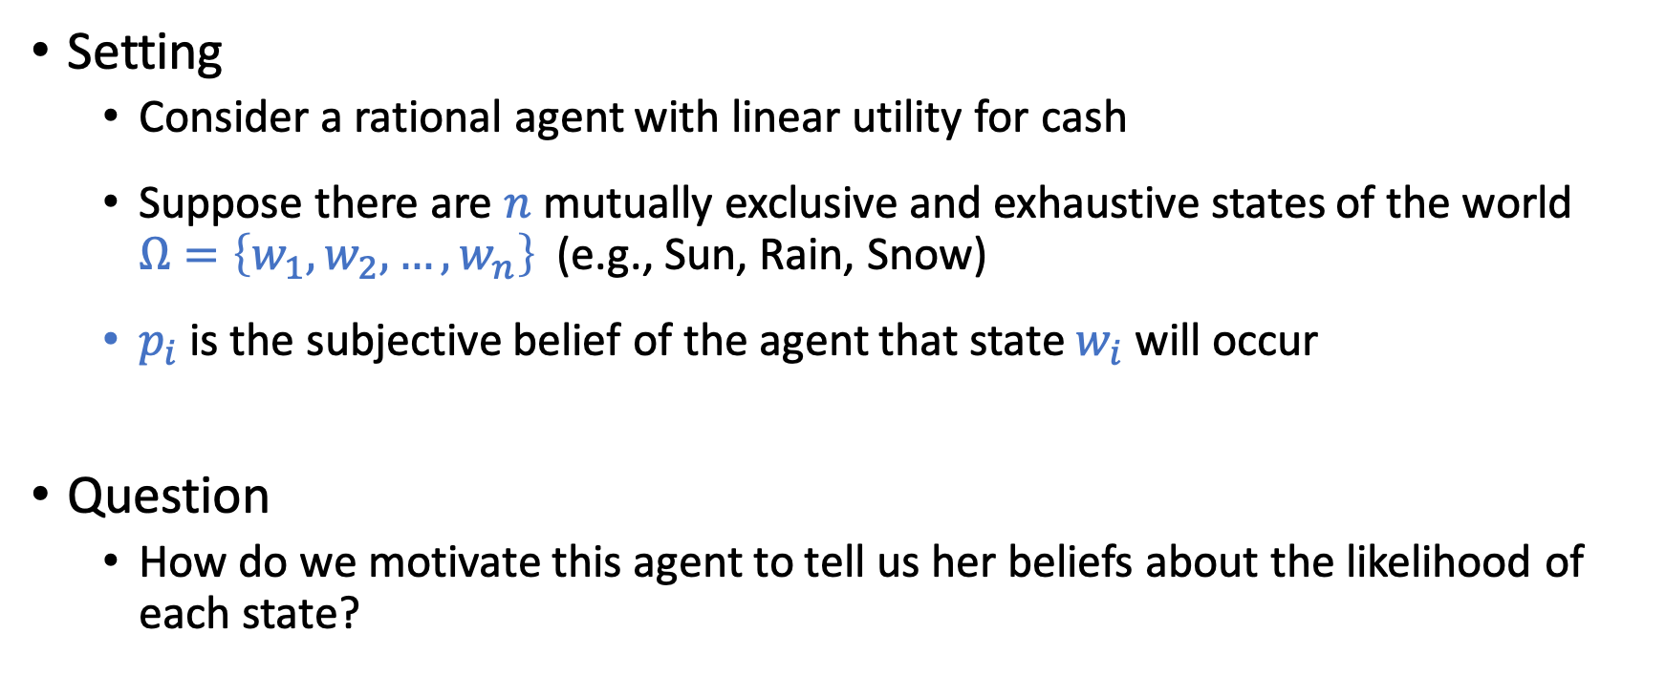
Incentivizing Truthful Reports
Setting
Consider a rational agent with linear utility for cash
Suppose there are $n$ mutually exclusive and exhaustive states of the world $Ω=\left\{w_{1},w_{2},…,w_{n}\right\}$ (e.g., Sun, Rain, Snow)
$p_{i}$ is the subjective belief of the agent that state $w_{i}$ will occur
Question
How do we motivate this agent to tell us her beliefs about the likelihood of each state?

Slide 38
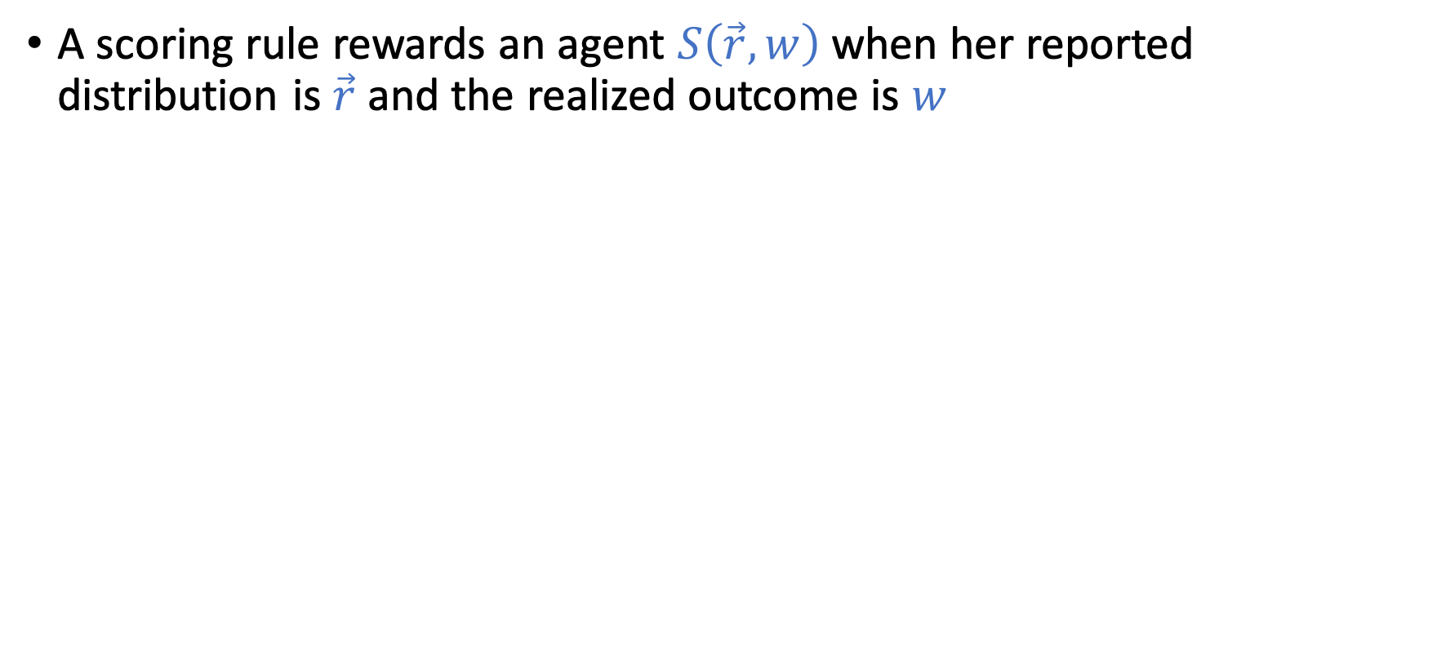
Scoring Rules
A scoring rule rewards an agent $S\left(\vec{r},w\right)$ when her reported distribution is$\vec{r}$ and the realized outcome is $w$

Slide 39
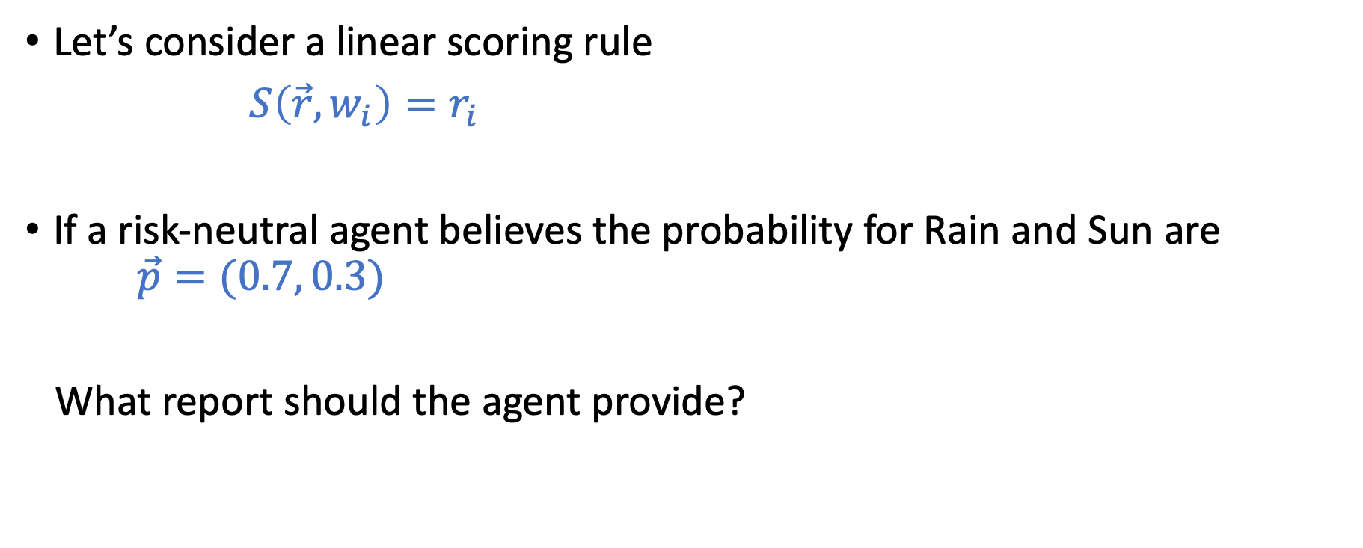
Scoring Rules
Let’s consider a linear scoring rule
$S\left(\vec{r},w_{i}\right)=r_{i}$
If a risk-neutral agent believes the probability for Rain and Sun are $\vec{p}=(0.7, 0.3)$
What report should the agent provide?

Slide 40
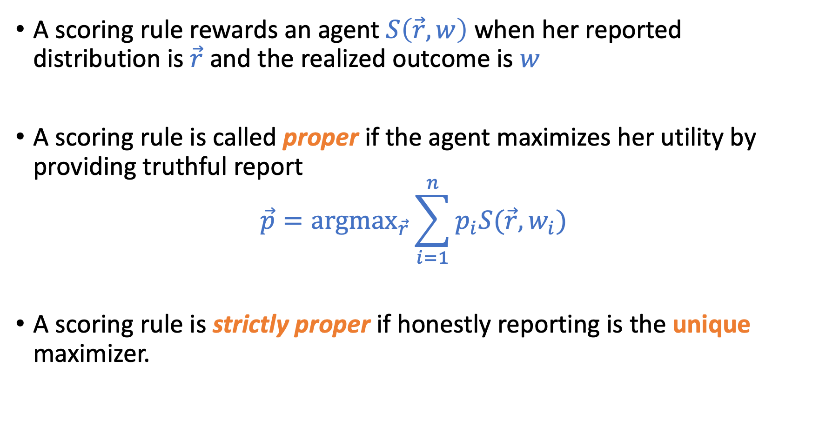
Scoring Rules
A scoring rule rewards an agent $S\left(\vec{r},w\right)$ when her reported distribution is$\vec{r}$ and the realized outcome is $w$
A scoring rule is called proper if the agent maximizes her utility by providing truthful report
$$\vec{p}=\text{argma}{\text{x}}_{\vec{r}}\sum_{i=1}^{n}{p_{i}S(\vec{r},w_{i})}$$
A scoring rule is strictly proper if honestly reporting is the unique maximizer.

Slide 41
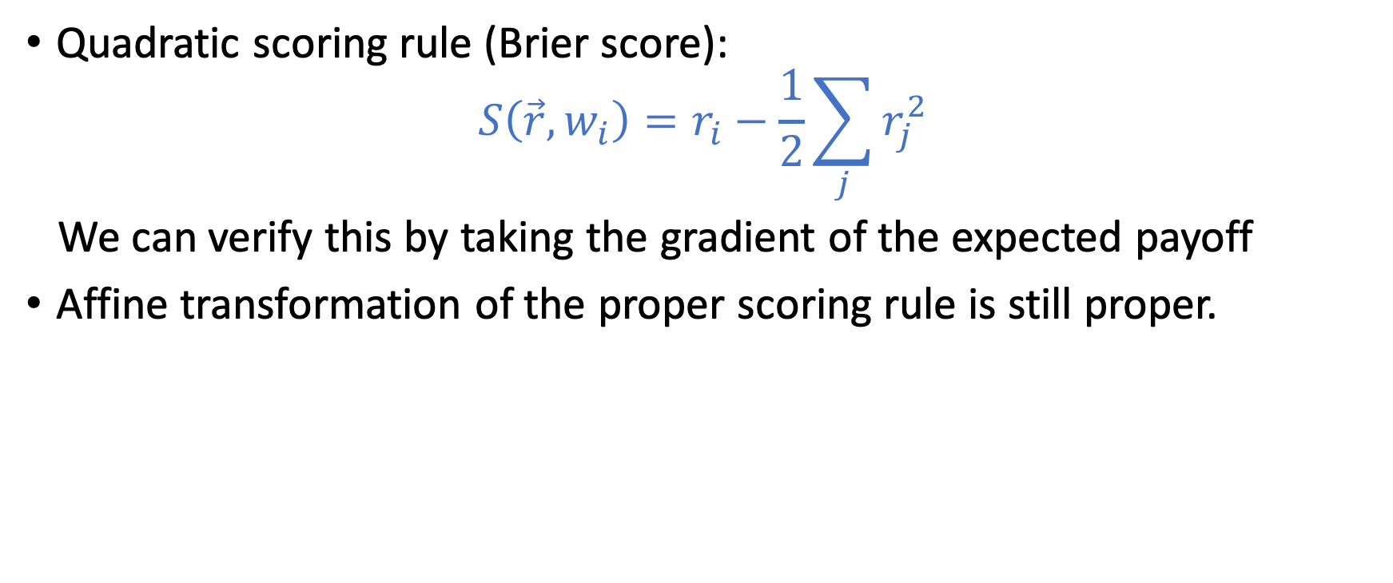
Examples of Strictly Proper Scoring Rules
Quadratic scoring rule (Brier score):
$$S\left(\vec{r},w_{i}\right)=r_{i}−\frac{1}{2}\sum_{j}{r_{j}^{2}}$$
We can verify this by taking the gradient of the expected payoff
Affine transformation of the proper scoring rule is still proper.

Slide 42
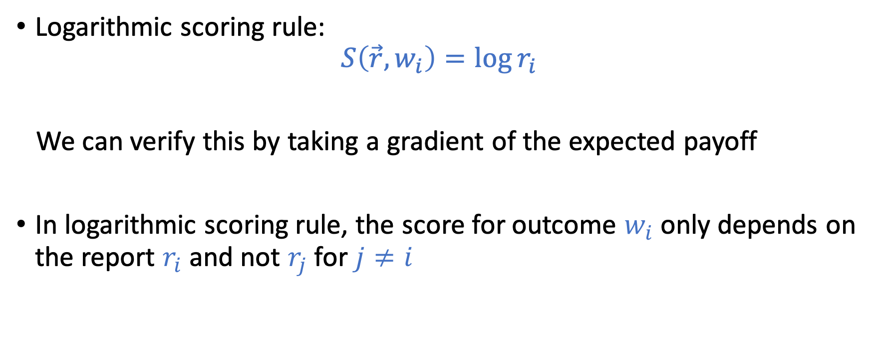
Examples of Strictly Proper Scoring Rules
Logarithmic scoring rule:
$$S\left(\vec{r},w_{i}\right)=\log{r_{i}}$$
We can verify this by taking a gradient of the expected payoff
In logarithmic scoring rule, the score for outcome $w_{i}$ only depends on the report $r_{i}$ and not $r_{j}$ for $j≠i$

Slide 43
More examples?
How do we construct a strictly proper scoring rule?
How many strictly proper scoring rules are there?

Slide 44
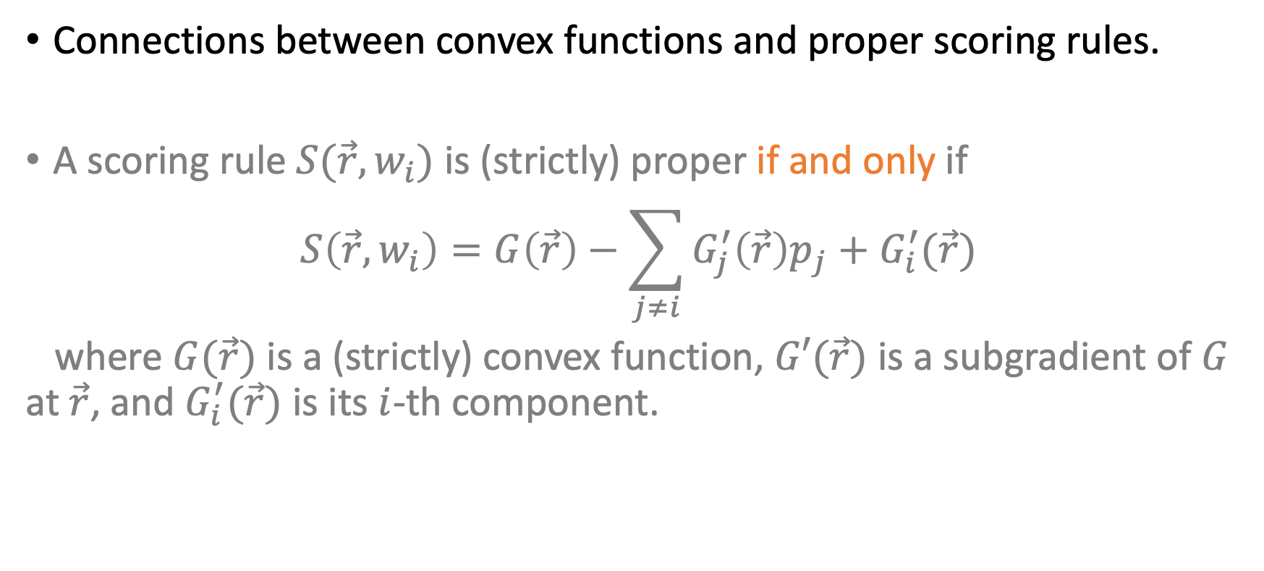
Characterization of Proper Scoring Rules
Connections between convex functions and proper scoring rules.
A scoring rule $S(\vec{r},w_{i})$ is (strictly) proper if and only if
$$S\left(\vec{r},w_{i}\right)=G\left(\vec{r}\right)−\sum_{j≠i}{G_{j}^{′}\left(\vec{r}\right)p_{j}+G_{i}^{′}(\vec{r})}$$
where $G(\vec{r})$ is a (strictly) convex function, $G′(\vec{r})$ is a subgradient of $G$ at $\vec{r}$, and $G_{i}^{′}(\vec{r})$ is its $i$-th component.
Section 3.1 of Strictly Proper Scoring Rules, Prediction, and Estimation by Gneiting and Raftery.

Slide 45
Connection to Prediction Market

Slide 46
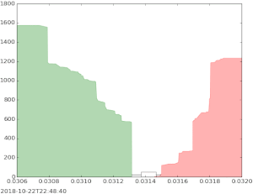
Designing Automatic Market Makers
Traditional market mechanisms might not work when the market is thin

Slide 47
Designing Automatic Market Makers
Goal of the market maker
Incentivize multiple agents to share their beliefs, and find a way to aggregate these beliefs into a unified prediction
1. Could use one scoring rule per agent, but not clear how to aggregate
2. Market itself is an aggregation mechanism (use final price as the prediction). However, standard stock-market-style trading might encounter issues for less popular predictions (market is too thin).

Slide 48
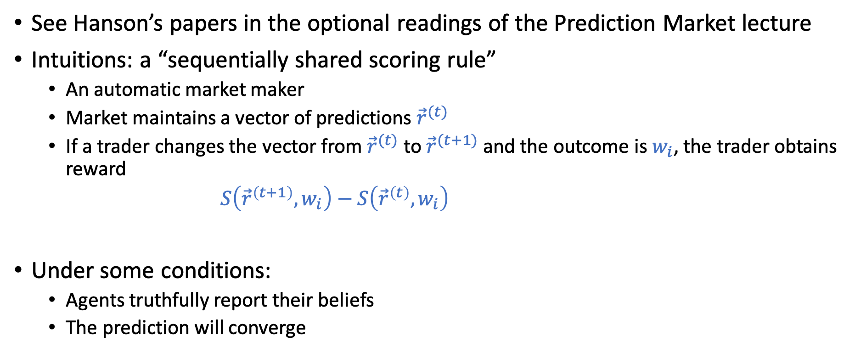
Market Scoring Rules
See Hanson’s papers in the optional readings of the Prediction Market lecture
Intuitions: a “sequentially shared scoring rule”
An automatic market maker
Market maintains a vector of predictions ${\vec{r}}^{(t)}$
If a trader changes the vector from ${\vec{r}}^{(t)}$ to ${\vec{r}}^{(t+1)}$ and the outcome is $w_{i}$, the trader obtains reward
$S\left({\vec{r}}^{\left(t+1\right)},w_{i}\right)−S\left({\vec{r}}^{\left(t\right)},w_{i}\right)$
Under some conditions:
Agents truthfully report their beliefs
The prediction will converge

Slide 49
Market Scoring Rules
The connection to convex optimization opens up an interesting line of research in the design of efficient market maker…

Slide 50
We won’t cover too much on prediction markets. In case you are interested, below are a few more papers to follow up:
A New Understanding of Prediction Markets Via No-Regret Learning. Chen and Vaughan. EC 2010.
An Optimization-Based Framework for Automated Market-Making. Abernethy, Chen, and Vaughan. EC 2011.
and more (the papers by these authors)

Slide 51
Very Brief Intro of Peer Prediction
See more discussion in Assignment 3

Slide 52
Eliciting Truthful Reports
Scoring rule relies on the “truth” to be revealed in the future
What if there is no ground truth (or the ground truth is hard to obtain)
Do you like this movie?
Peer grading in MOOCs
Output agreement:
Randomly pick two persons
If their reports match, reward them 1, otherwise reward 0
Truthful reporting is not an equilibrium (you are encouraged to report the majority’s opinion)

Slide 53
Peer Prediction
How to fix the issue?
Assume knowledge about the report distribution, re-weighting the rewards to make sure truthful reporting is a equilibrium
Drawbacks:
Require knowledge of the prior
There are usually multiple equilibrium (including naïve bad ones…)
Still an ongoing research area
Some nice theoretical results, however there is little practical success so far
Eliciting Informative Feedback: The Peer-Prediction Method. Miller et al. 2004

Slide 54
Related Course
The course on peer grading at Northwestern by Jason Hartine.
https://sites.northwestern.edu/hartline/eecs-497-peer-grading/

Slide 55
Assignment 3

Slide 56
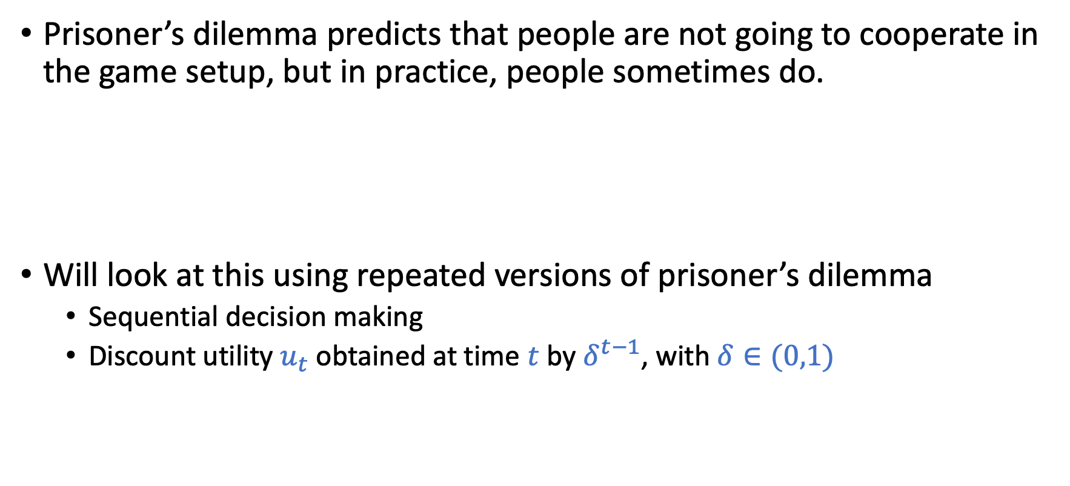
Cooperation and Repeated Prisoner’s Dilemma
Prisoner’s dilemma predicts that people are not going to cooperate in the game setup, but in practice, people sometimes do.
Will look at this using repeated versions of prisoner’s dilemma
Sequential decision making
Discount utility $u_{t}$ obtained at time $t$ by $δ^{t−1}$, with $δ∈(0,1)$

Slide 57
Peer Grading and Peer Prediction
Can we design ”incentives” for peer grading?
Ground truth (goodness of assignment) is hard to obtain
Students (graders) have noisy signals that reveal the assignment quality
Want to incentivize graders to truthfully reveal the signals
Randomly pick two students to grade the same assignment
Simply rewarding “the same report” is probably not a good idea
Every grader can just give high score for every assignment
How should we do it?
Common prior:
80% of the assignments are “good”

Slide 58
Information Design with Bayesian Persuasion
A company wants to hire interns from our class and asks me for recommendation letters
Assumption
30% of students are “good” -> meet their requirement
They don’t know who are good but I know
How do I write letters to maximize the number of students getting hired?

